Slide 1


Lent Calendar 2021
February
17
18
19
22
23
24
25
26
March
1
2
3
4
5
8
9
10
11
12
15
16
17
18
19
22
23
24
25
26
29
30
31
1
2
April

Slide 2
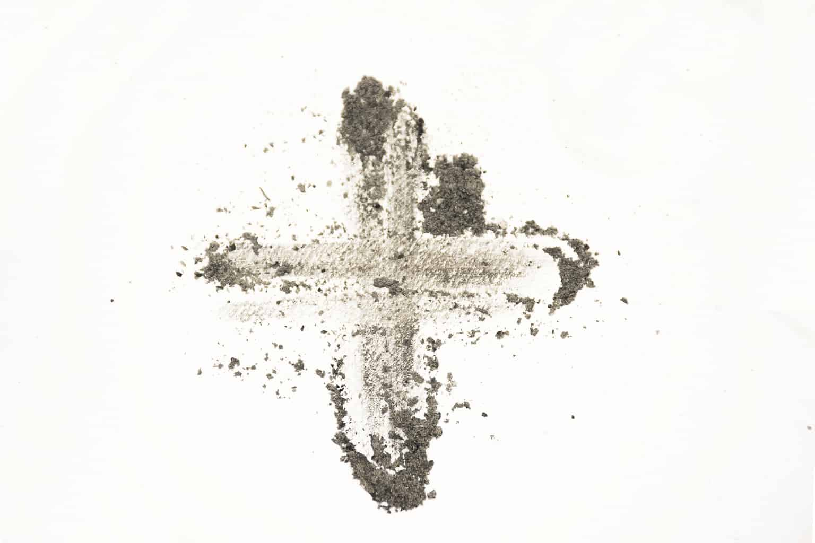

Wednesday 17 February
Think about…
As Lent begins, we remember how Jesus spent 40 days in the desert.
While Jesus was in the desert he had very little to eat or drink.
There are many people around the world who do not have the rights to basic things like enough food or clean water.
Throughout Lent we will think about our neighbours around the world who don’t have enough to drink.
Click here for a Lent liturgy (perfect for Ash Wednesday)

Slide 3

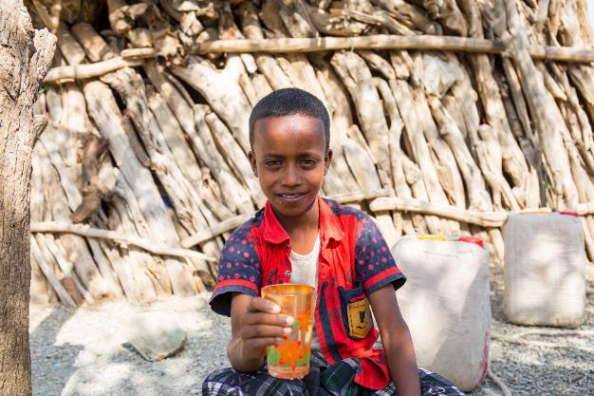
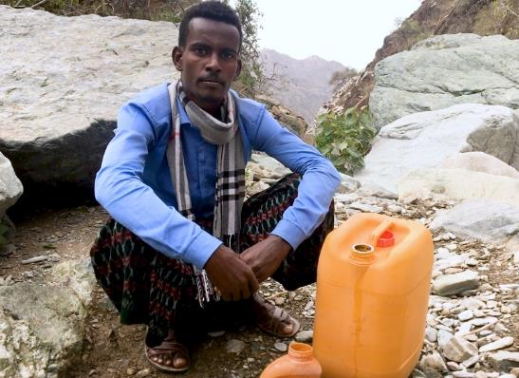
Thursday 18 February
Act
This Lent, we are thinking about our global neighbours who don’t have access to safe, clean water.
Meet Abdul in Ethiopia and find out about his cousin Abdella’s daily walk for water.
Watch our film to find out more

Slide 4

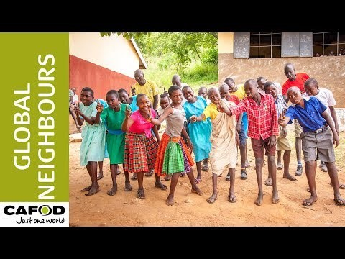
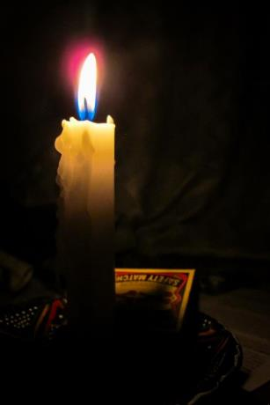
Friday 19 February
Pray
Light a candle and pray for all our global neighbours, using this film.

Slide 5
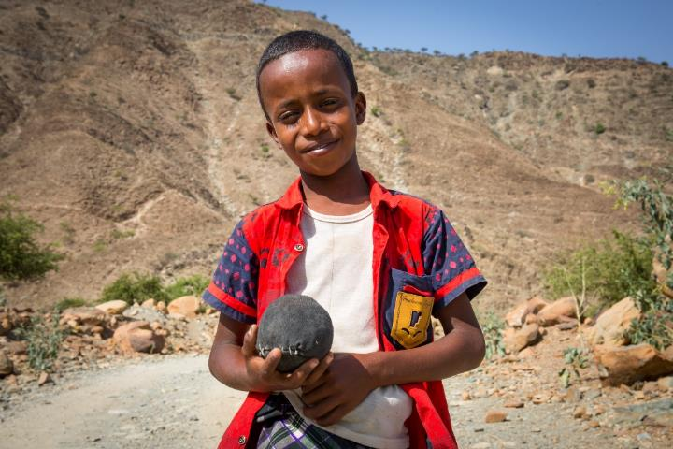
Monday 22 February
Pray
Abdul lives in Ethiopia, in a region called Afar. It is one of the hottest places on Earth, and is getting even hotter because of climate change.
It is hard to find safe, clean water. Abdul’s cousin Abdella makes a five hour journey, twice a day, to collect water.
We remember those who do not have enough water today.
Loving God,
fill our hearts with compassion for the earth and all its peoples. Lead us to be good neighbours to all who are in need.
Amen

Slide 6
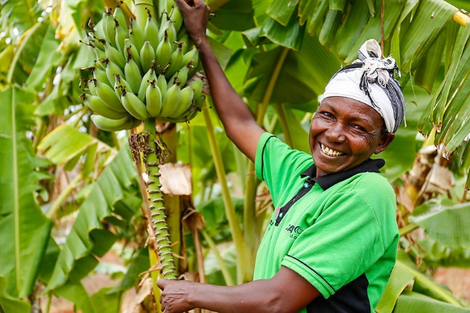
Tuesday 23 February
Act
It’s Fairtrade fortnight.
Find out whether your local shop sells Fairtrade Easter eggs. If not, ask them why not and if they will stock them next year.
Find our Fairtrade resources here

Slide 7
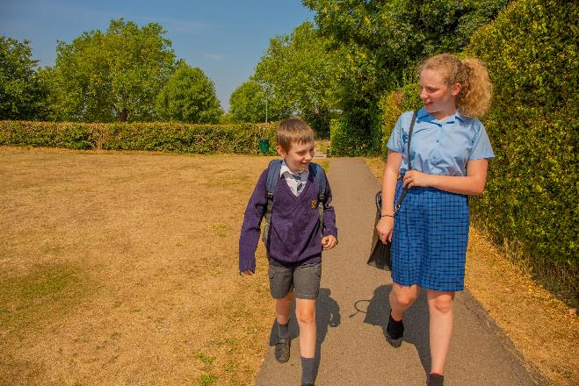

Wednesday 24 February
Pray
Give
This Lent, schools in England and Wales are walking for water to help people like Abdul and Abdella to have access to clean water.
Lord,
may my support bring hope to people who are in difficulty around the world.
May they know that you are with them and that they have sisters and brothers who care for them.
Amen
Find out more at cafod.org.uk/primary

Slide 8
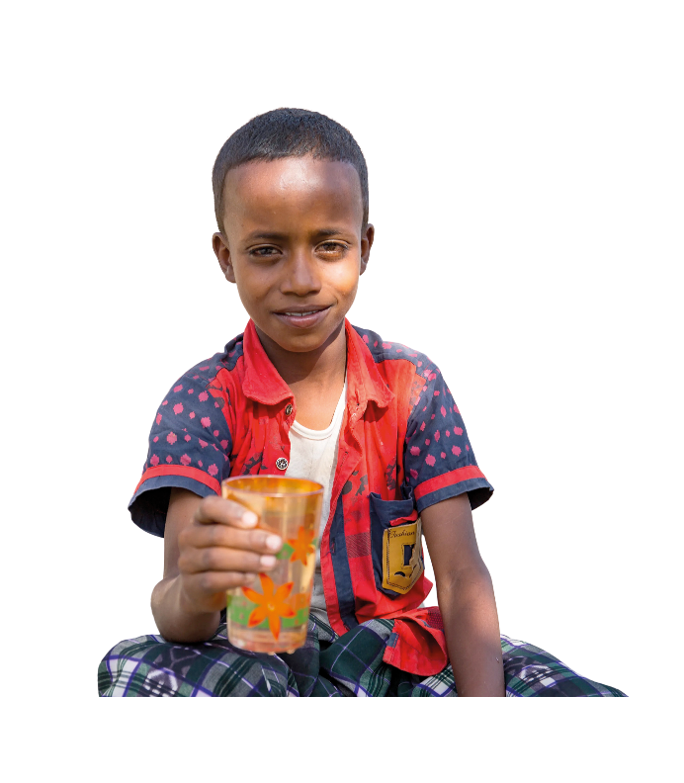

Thursday 25 February
Pray
Find out more about Abdul and the importance of water, and how you can make a difference – watch our national assembly ‘Water of Life’.
Watch the assembly

Slide 9
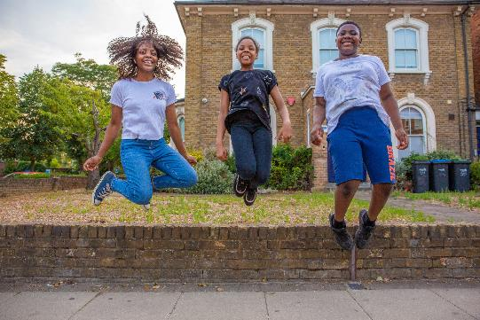
Friday 26 February
Today is Family Fast Day!
However you raise money today will support our global neighbours like Abdul and Abdella in Ethiopia.
Find out how to Walk for Water

Slide 10
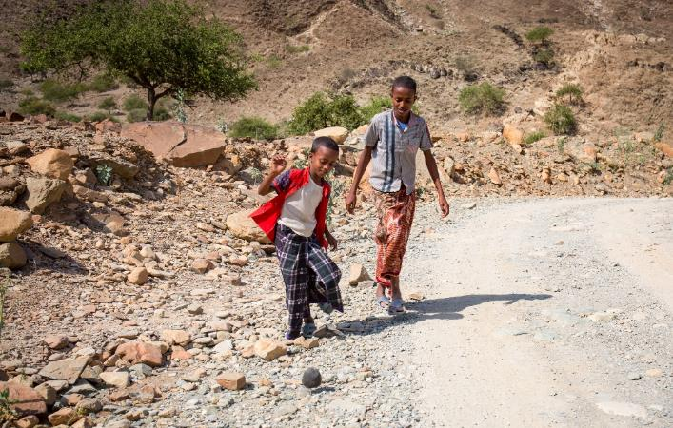
Monday 1 March
Pray
Abdul is 8 years old. He is a cheerful boy and likes to play football and volleyball with his brother, Mohammed.
My favourite drink is water. Water is life.
Loving God,
fill our hearts with compassion for the earth and all its peoples. Lead us to be good neighbours to all who are in need.
Amen

Slide 11
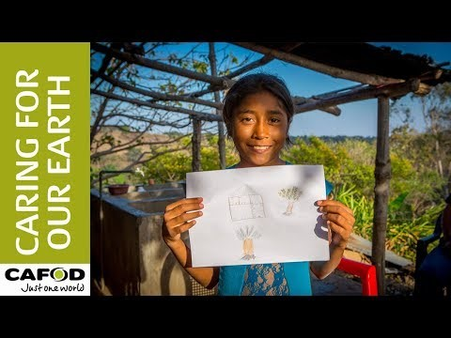
Tuesday 2 March
Pray
Light a candle and pray for our Earth, using this film.

Slide 12

Wednesday 3 March
Pray
Give
This Lent, schools in England and Wales are raising money to support our global neighbours.
There are lots of ways you can do this!
Lord,
may my support bring hope to people who are in difficulty around the world.
May they know that you are with them and that they have sisters and brothers who care for them.
Amen
Find out more at cafod.org.uk/primary

Slide 13

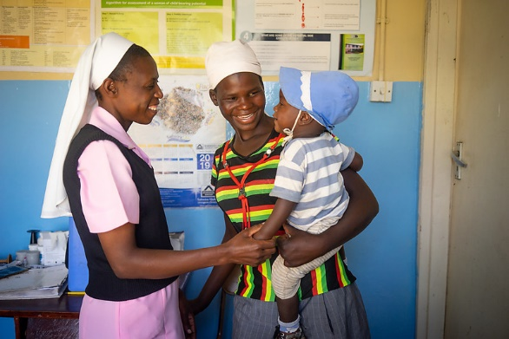
Thursday 4 March
Think about…
“I have come so that they may have life, and have it to the full”
John 10:10
Say these words together and spend some time today thinking about them.
  Where do these words come from?
  What do they mean?
  How can we live by them?

Slide 14
Friday 5 March
Pray
Light a candle and say a prayer so all children around the world may have the basic things in life, like enough food or clean water.
Loving God,
Help us to work together to share what we have so that everyone has what they need.
Help us to build a better world where each of us can become the best person we can be.
Amen

Slide 15
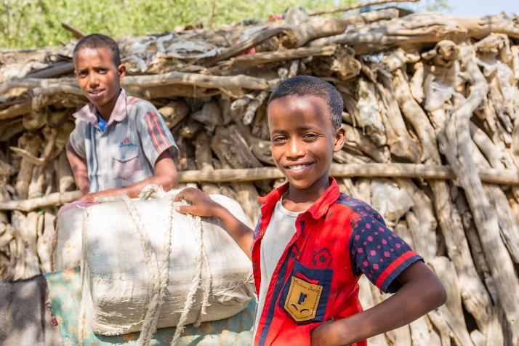

Monday 8 March
Pray
This Lent we have been learning about Abdul and his family in Ethiopia.
He likes to help his mum at home and wants to be a teacher when he grows up.
My favourite food to eat is honey. I love it!
When I eat it I feel strong.
Loving God,
fill our hearts with compassion for the earth and all its peoples. Lead us to be good neighbours to all who are in need.
Amen

Slide 16
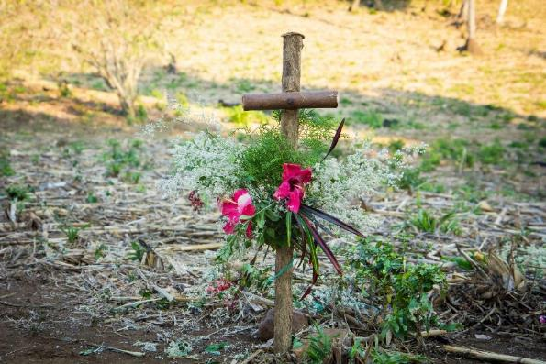
Tuesday 9 March
Pray
Reflect on one of the Stations of the Cross today.

Slide 17
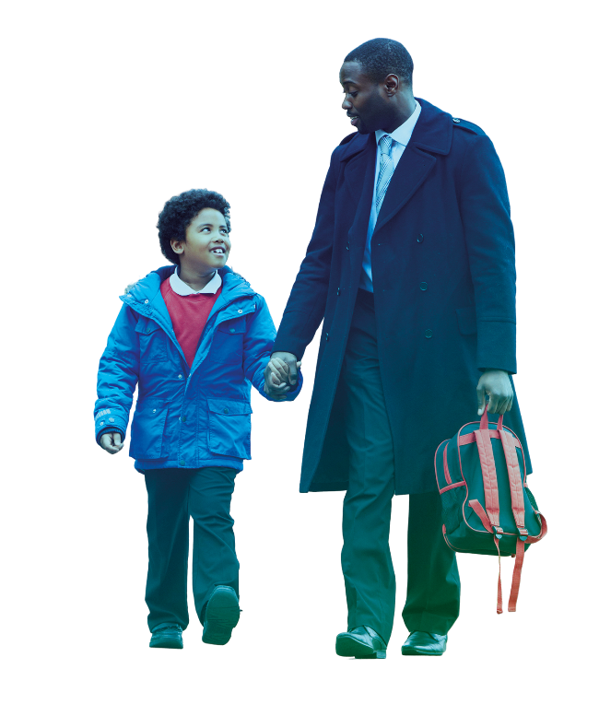
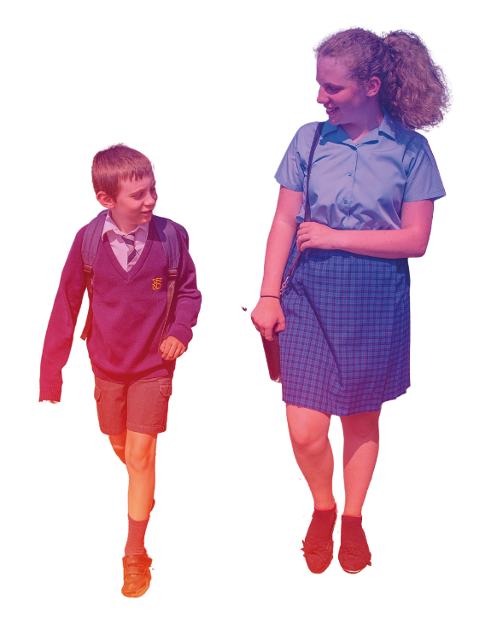
Wednesday 10 March
Pray
Give
However you raise money this Lent, you can help our global neighbours like Abdul, Abdella and their family.
Lord,
may my support bring hope to people who are in difficulty around the world.
May they know that you are with them and that they have sisters and brothers who care for them.
Amen
What creative ways can you think of to fundraise for our brothers and sisters around the world?
Find out more at cafod.org.uk/primary

Slide 18
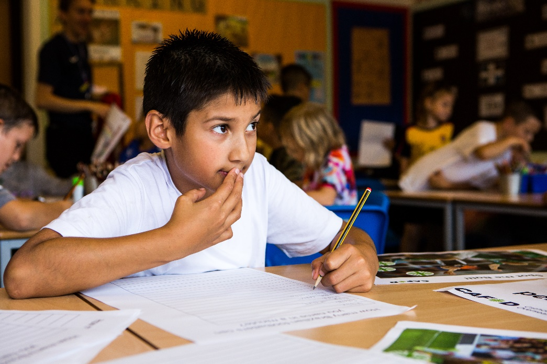
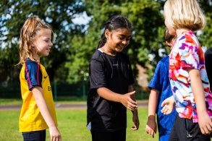
Thursday 11 March
Act
What action will you take to show kindness to others today?
Think of at least three things you can do today and during the next week of Lent.
You could think of three different people to show kindness to, maybe someone you don’t always get on with or someone you wouldn’t normally talk to.

Slide 19
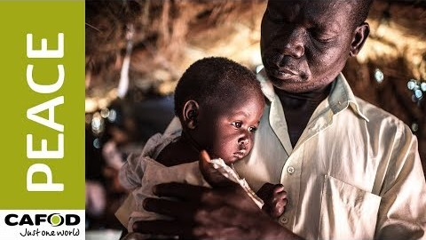
Friday 12 March
Pray
God of love,
We pray for peace in our world, and an end to war.
Instead of hatred, let there be love.
Shelter your children and protect us.
Guide us and keep us from harm,
so we can build a world of love and live our lives in peace.
Amen.
Notes:
Photo credit: Zinyange Autony

Slide 20
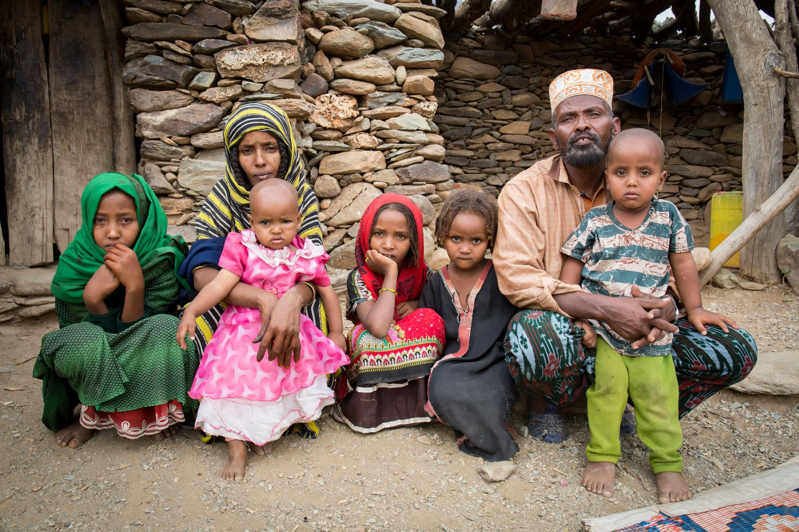
Monday 15 March
Pray
Abdellah
We have been learning about Abdul and his family this Lent and raising money to help people like him. But how does your money help?
This is Abdellah. He lives with his family in another part of Afar. He used to have to walk 3 hours to fetch water.
Through CAFOD’s local experts, Abdellah’s community now has a solar powered water pump that gives enough water to drink and grow vegetables to eat.
Loving God,
fill our hearts with compassion for the earth and all its peoples. Lead us to be good neighbours to all who are in need.
Amen

Slide 21
Tuesday 16 March
Pray
Reflect on one of the Stations of the Cross today.

Slide 22
Wednesday 17 March
Pray
Light a candle and say a prayer so all children around the world may have the basic things in life, like enough food or clean water.
Loving God,
Help us to work together to share what we have so that everyone has what they need.
Help us to build a better world where each of us can become the best person we can be.
Amen

Slide 23
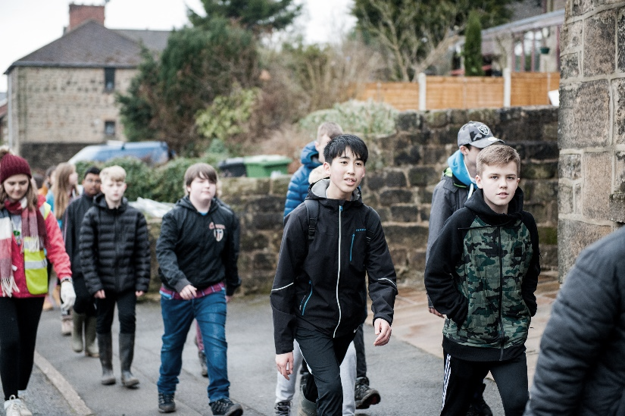
Thursday 18 March
Pray
Give
This Lent, schools in England and Wales have been raising money to help our global neighbours.
Lord,
may my support bring hope to people who are in difficulty around the world.
May they know that you are with them and that they have sisters and brothers who care for them.
Amen
There is still time to organise a walk or another fundraiser!
Find out more at cafod.org.uk/primary

Slide 24

Friday 19 March
Pray
Dear God,
You understand the pain of loss,
May we hold in our hearts all those whose families or friends have died.
You help us in times of fear,
May we help each other even as we keep apart.
You move our hearts to share,
May we share what we have with those in need.
God of life,
We thank you for the signs of your light in the middle of darkness;
May we be signs of your compassion in the heart of your world.
Amen

Slide 25
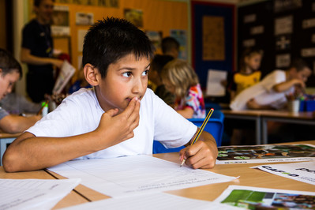
Monday 22 March
Act
Easter is nearly here.
Start getting ready by making Easter cards for your family and friends.
Creator God,
open our eyes to see your love throughout creation.
Inspire us to treat creation and each other as you would, with respect.
Amen.

Slide 26
Tuesday 23 March
Pray
Reflect on one of the Stations of the Cross today.

Slide 27
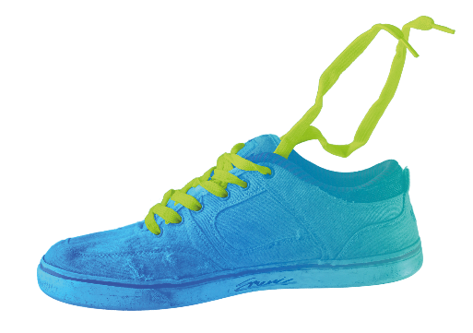

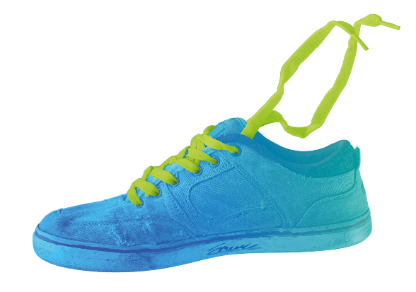
Wednesday 24 March
Give
There is still time to hold your fundraiser this Lent.
Find out more at cafod.org.uk/primary

Slide 28
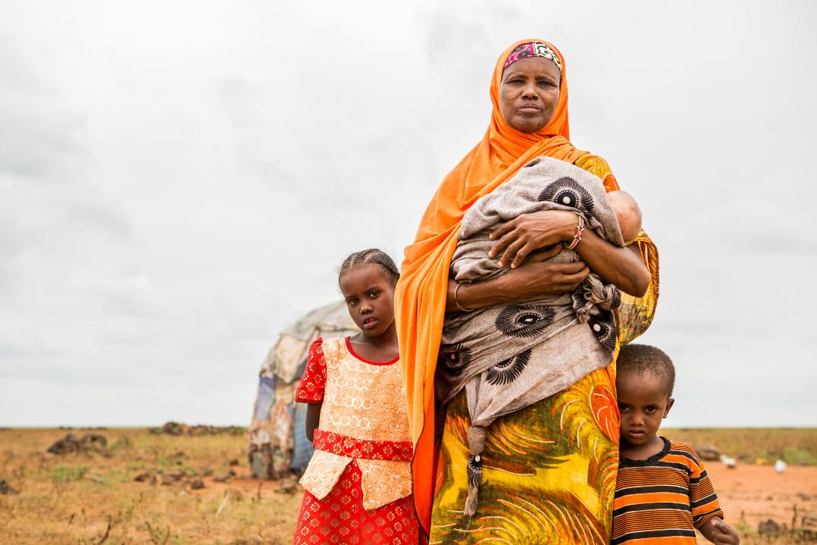
Thursday 25 March
Pray
Today we celebrate a special day called the Annunciation.
It’s the day when we celebrate the angel Gabriel visiting Mary to tell her the good news that she would be the mother of Jesus.
Let us pray
Hail Mary, full of grace, the Lord is with thee;
blessed art thou among women, and blessed is the fruit of thy womb, Jesus.
Find our annunciation resources here
Holy Mary Mother of God,
pray for us sinners,
now and at the hour of our death.
Amen

Slide 29
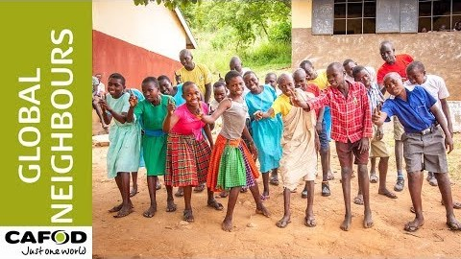
Friday 26 March
Pray
This Lent we have heard stories from people in Ethiopia.
Pray for all our global neighbours.
Dear God,
Speak to our hearts and help us to see that we are one big family.
Old or young, short or tall, wherever we live, you made us all.
Help us to share, however hard it seems, to make our world fair,
And live out our dreams.
Amen.

Slide 30
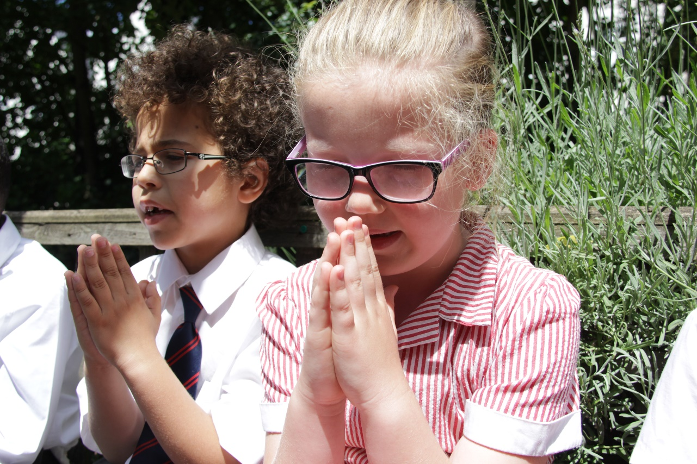
Monday 29 March
Pray
Creator God,
open our eyes to see your love throughout creation.
Inspire us to treat creation and each other as you would, with respect.
Amen

Slide 31
Tuesday 30 March
Pray
Reflect on one of the Stations of the Cross today.

Slide 32
Wednesday 31 March
Pray
Light a candle and say a prayer so all children around the world may have the basic things in life, like enough food or clean water.
Loving God,
Help us to work together to share what we have so that everyone has what they need.
Help us to build a better world where each of us can become the best person we can be.
Amen

Slide 33
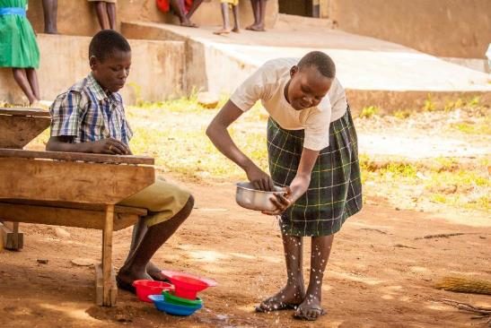
Thursday 1 April
Think about…
Holy Thursday
Today Jesus washed his disciples feet at the Last Supper.
Think about how you can serve others.

Slide 34
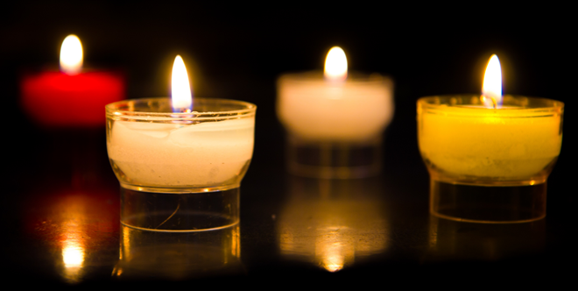
Friday 2 April
Pray
Good Friday
Say a prayer today for people around the world who live in poverty.
Remember those families that do not have basic things like food, housing and clothing.

